Slide 1
Series Warmup

Slide 2
A really bad way to maintain order
Given a list L in order
Suppose elements get added dynamically
Problem is to keep it in order
Joe has a sort function available Sort(L)
He learned in CS50 not to reinvent any wheels
So when a new element x arrives he appends it to the end of L: L <- append(L,x) and then calls Sort(L)
Unbeknownst to Joe, Sort does a bubble sort
How many item comparisons, starting from an empty list and adding n elements?

Slide 3
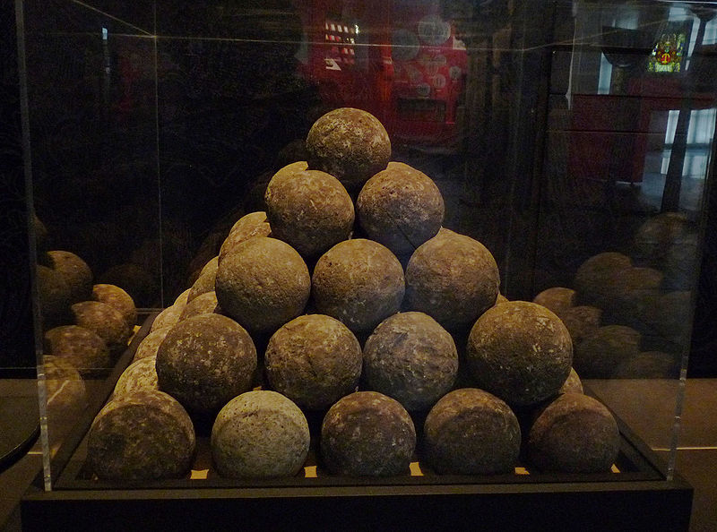
Recall Bubble Sort Analysis
((i-1)∙i)/2 comparisons to sort a list of length i
So
But what is the sum of the first n squares?

Slide 4
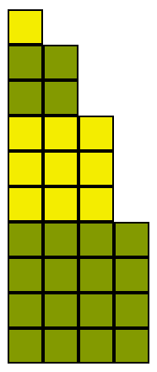
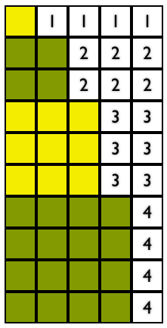
n=4, sum of first 4 squares
Area = n across and tall
How big is the white space?
Let

Slide 5
Of course this is Θ(n³)!

Slide 6
FINIS

